Slide 1

Python Dat Processing
CSV & JSON files

Slide 2
Introduction to CSV
CSV (Comma Separated Values) is a simple file format used to store tabular data, such as a spreadsheet or database.
A CSV file stores tabular data (numbers and text) in plain text.
Each line of the file is a data record. Each record consists of one or more fields, separated by commas.
The use of the comma as a field separator is the source of the name for this file format.
For working CSV files in Python, there is an inbuilt module called CSV.
CSV (Comma Separated Values) format is the most common import and export format for spreadsheets and databases.

Slide 3
Reading a CSV File
Reading from a CSV file is done using the reader object.
The CSV file is opened as a text file with Python’s built-in open() function, which returns a file object.
In this example, we first open the CSV file in READ mode, file object is converted to csv.reader object and further operation takes place.

Slide 4
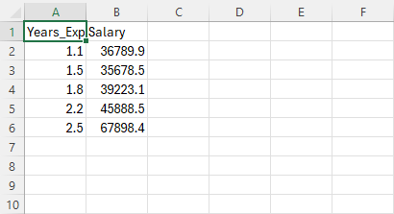
CSV File(salary.csv)

Slide 5
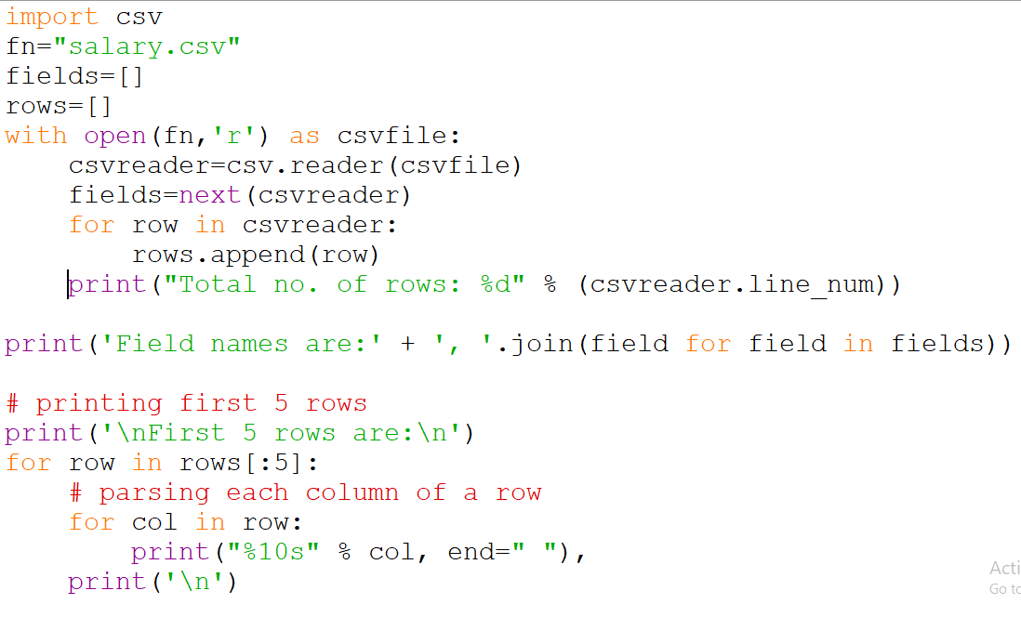

Slide 6
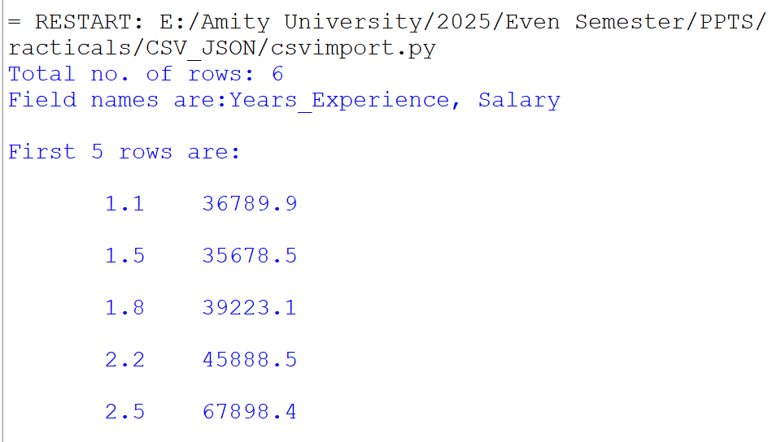
Output

Slide 7
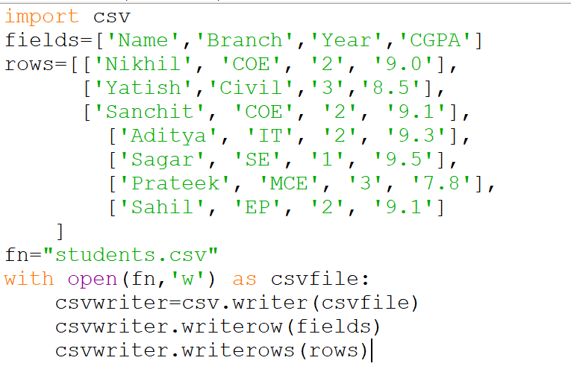
Writing in a CSV file

Slide 8
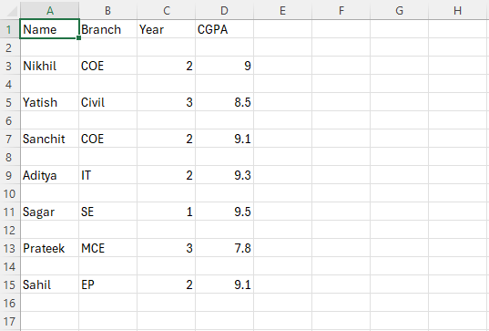
Student.csv file

Slide 9
The End

